Slide 1
Chatbot for Customer Support

Slide 2
Problem Statement
Objective
Build a chatbot capable of recognizing user intent in real-time and providing appropriate responses.
Focus on natural language understanding (NLU) in the context of customer support.
"Design a chatbot to respond to user queries in the customer support domain, focusing on common intents (e.g., order tracking, account management)."

Slide 3
Data set and overview
Dataset: Bitext Customer Support Dataset
Details:
Contains 20,000+ customer support utterances.
Covers 27 intents under 11 categories (e.g., order, payment, refunds).
Includes linguistic variations, spelling errors, slang, etc., to mimic real user interactions.
Data Structure:
Fields: Utterance, Intent, Category, Linguistic Flags (e.g., politeness, colloquial language).

Slide 4
Data Exploration and Preprocessing
Exploration:
Reviewed intent distributions and frequency of categories.
Assessed linguistic variations and flag-based annotations.
Preprocessing Steps:
Text Cleaning: Removed special characters and punctuation.
Tokenization: Transformed text data into token format.
Label Encoding: Encoded each intent as a label for model compatibility.

Slide 5
Model Selection and Training
Chosen Model: Logistic Regression (other models can be explored based on project scope)
Training Process:
Used TF-IDF (Term Frequency-Inverse Document Frequency) vectorization for feature extraction.
Split dataset into training and testing sets.
Trained the model on intent classification using Logistic Regression.

Slide 6
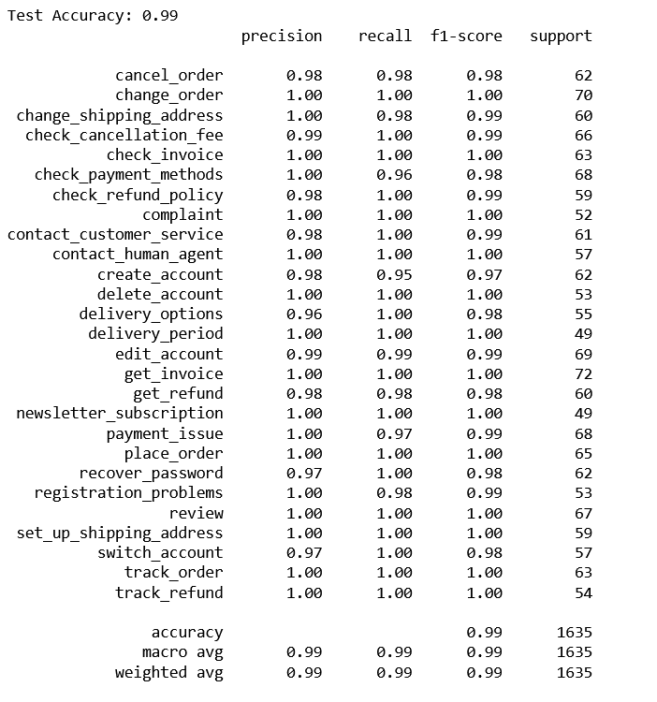
Model Evaluation
Evaluation Metrics:
Accuracy: Achieved 99% accuracy on test data.
Classification Report: Included detailed precision, recall, F1 scores.
Observations:
The classification report demonstrates that the model is highly accurate and robust in classifying intents within the customer support domain. The few minor discrepancies do not significantly impact the overall model performance, making it well-suited for deployment in a customer support chatbot.

Slide 7
Dialogue Management
Dialog Management:
Implemented basic dialog management for predicting responses based on intent.
Mapped intents to predefined responses (e.g., “cancel_order” → “Your order has been canceled.”)
Sample Interaction:
Example Query: “Can I cancel my order?”
Predicted Intent: cancel_order
Response: “Your order has been canceled.”

Slide 8
Thank you

